Slide 1
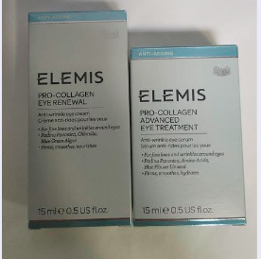
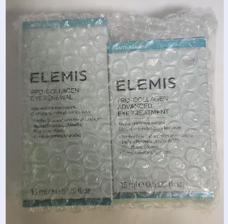
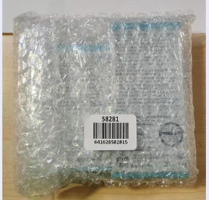
58281
Maritime Eye Duo Collection
ELEMIS NADC ASSEMBLY INTRUCTIONS
58281 | Kit: Maritime Eye Duo Collection
00231 | Pro-Collagen Advanced Eye Treatment 15ml
00273 | Pro-Collagen Eye Renewal 15ml
641628582815 | Barcode
1. We’ll be using the items below:
2. Place all item in this order
3. Use 8 x 11.5 bubble bag and place the barcode label in the center of the bag.
00273 | Pro-Collagen Eye Renewal 15ml
00231 | Pro-Collagen Advanced Eye Treatment 15ml

